Slide 1


Civil Society Elites? Comparing elite composition, reproduction, integration and contestation in European civil societies
Uia, round table Rotterdam, nov 2022. Professor Håkan johansson, lund university, sweden

Slide 2
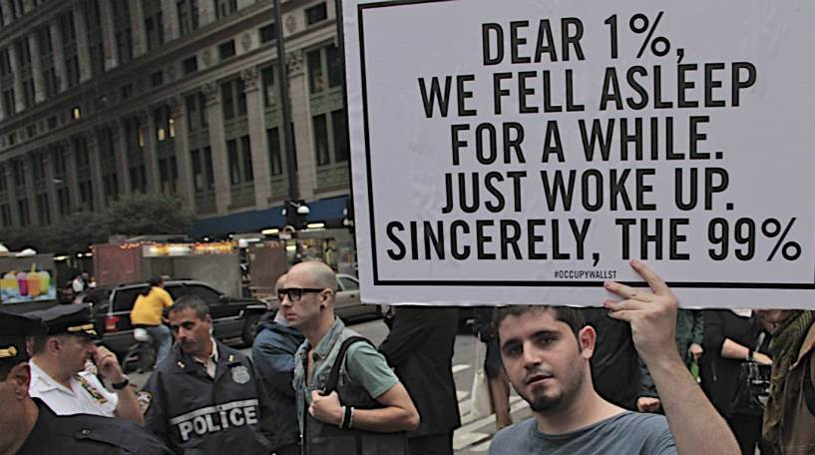

Slide 3
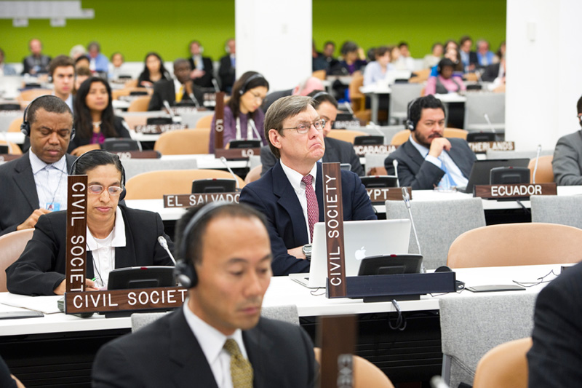

Slide 4

Pushing the research agenda
Elite research
  Civil society lack resources, formal authority and societal impact to be considered having an elite
Civil society research
  Civil society egalitarian and inclusive and leaders as a counter-elite.
But what if?
  Civil society and its leaders are similar as any other part of society, i.e. competition over resources and resource concentration at the top

Slide 5
Drawing on key themes in elite research
  What qualities, values and networks are associated with leaders of large CSOs?
  What avenues lead to key and inflential positions in civil society?
Comparisons across ’civil society regimes’ (Italy, Poland, Sweden, the UK and also EU level)
Mixed methods: survey data, biographical data, interviews and observations
Composition of elites
Reproduction of elites
Challengers to elites (TSIV)
Interaction and integration of elites
  By whom, how, and on what grounds are civil society elites power contested?
  Do elite groups in civil society interact, or integrate, with other elite groups?

Slide 6
Composition of civil society elites
Focus: cross country comparisons of those at the top, attitudes, capital and networks
Database(s) of powerful CSOs (300-400 in each context)
  Organizational ”Elite score” measuring resources and recognition
  Database of ”short biographies” of leaders at the top of the pyramid
  Database of interlock/networks of leaders in four countries and at EU level
  Survey of leaders of major CSOs in four countries, and at EU level
Outcomes: Social characteristics of those at the top in relation to other elite groups and the general population.
Score 5 (1 org.)
Score 3 (39 org.)
Score 2 (72 org.)
Score 4 (10 org.)
Score 1 (272 org.)

Slide 7

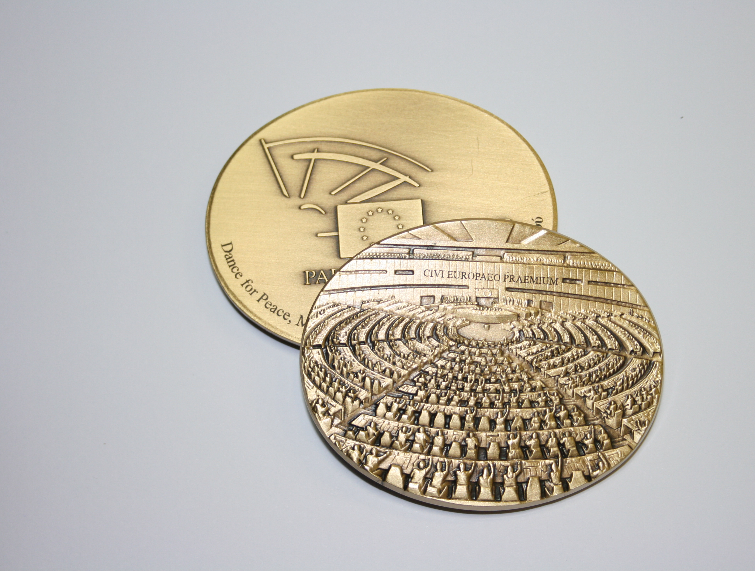
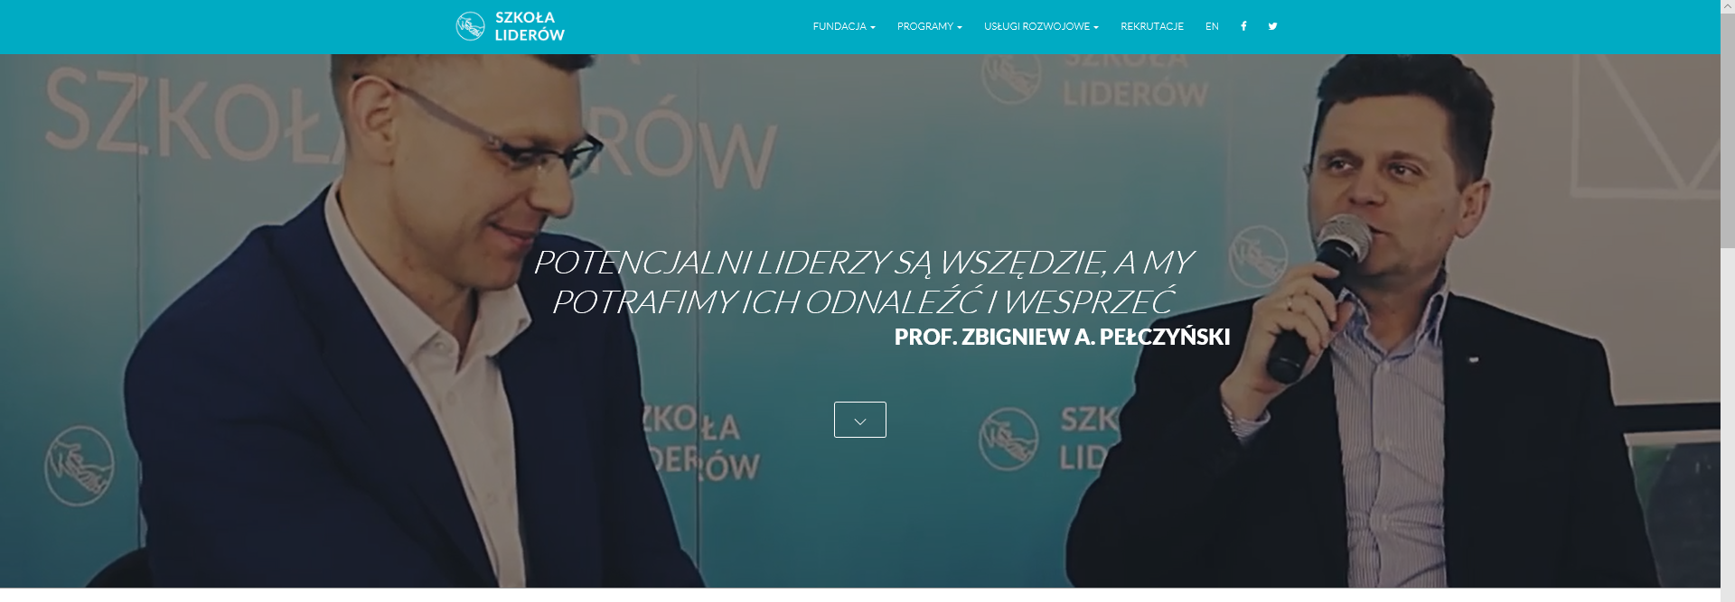
Reproduction of civil society elites
Focus: upward mobility into elite positions. Studies of four avenues into elite position: i) appointment, ii) recruitment, iii) training and iv) prizes
Empirical examples: Review of leadership programs and civil society prizes; recruitment of leaders; announcements of leaders (presidents/directors)
Outcome: Elite vs leader backgrounds and capitals. Elites should be charismatic, more important than able to represent.

Slide 8
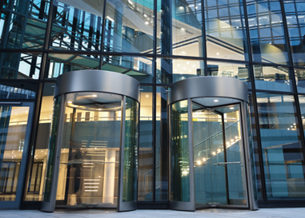
Integration of civil society elites
Focus on: Revolving doors between politics, business and civil society. What types of resources are used, gained, and lost when moving across fields.
Empirical work: interviews with boundary-crossers; ethnographic research at arenas at of elite integration
Outcome: High degrees of elite integration in UK, less in Sweden, Italy or Poland. Power elites do not recognize sector differences, they just move.

Slide 9
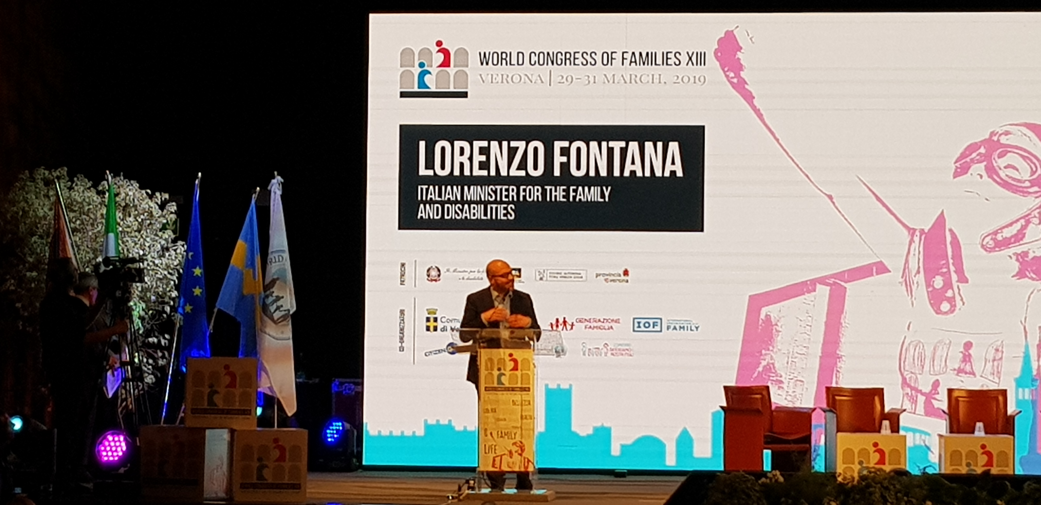
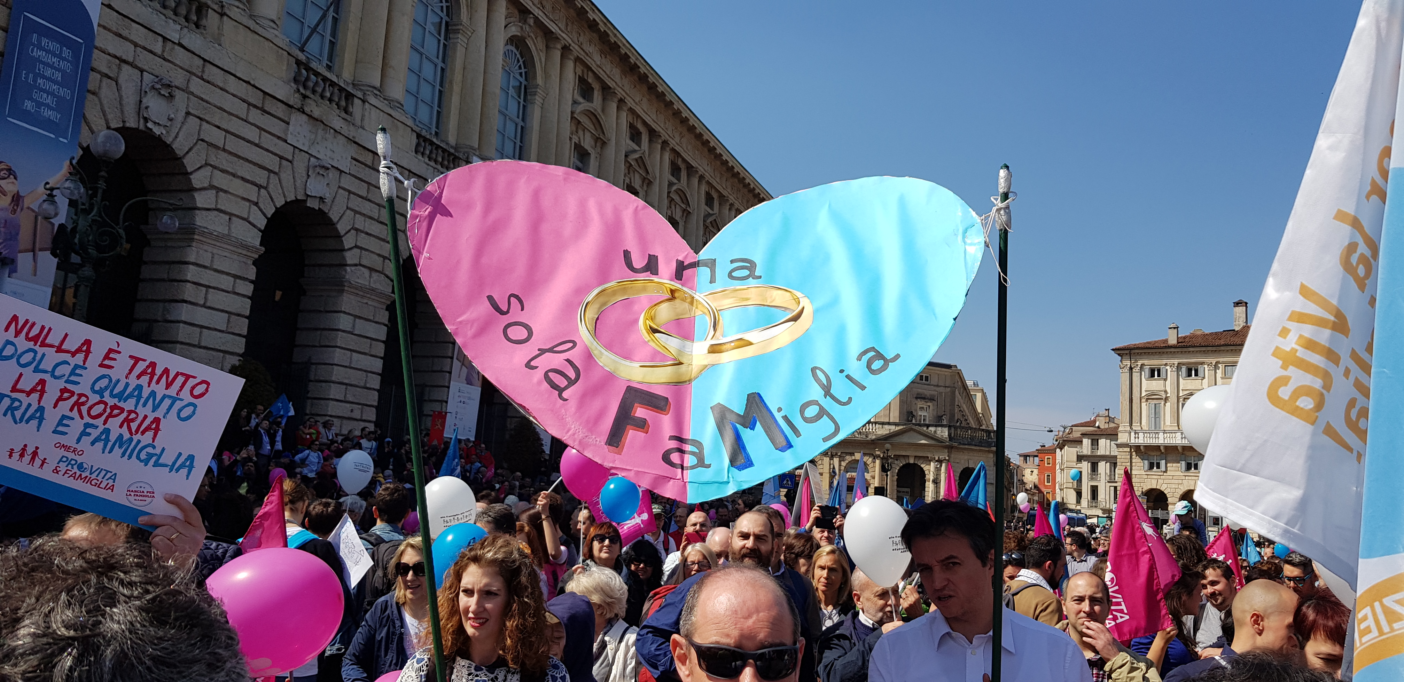
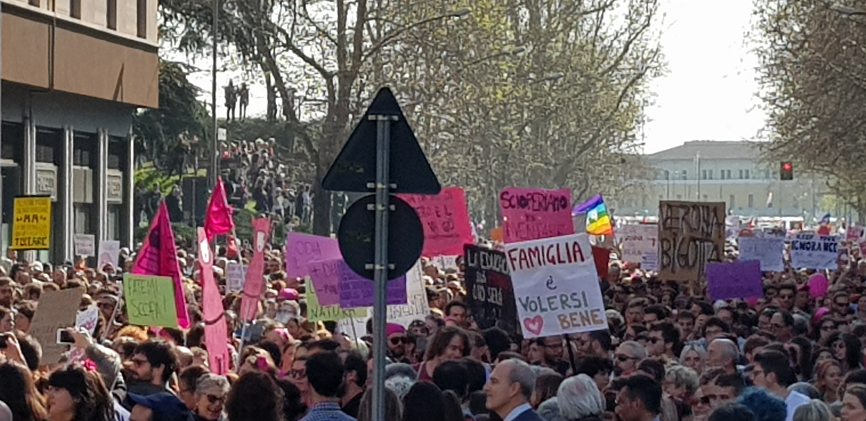
Challengers to civil society elites
Focus on: The challenges and challengers to civil society elites. Political and business elites acting as counter-elites against CS elites.
Empirical examples: a) bottom-up challengers to civil societty elites, e.g. mobilization against homogeneity at the top; b) elite challengers emerging divides between liberal and conservative elites in societies
Outcomes: Elites as in flux. Ideology as ground for elite identification and contestation. Contested definition of elites and counter elites in populist times.

Slide 10
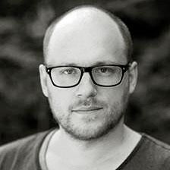
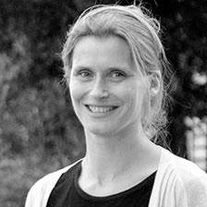
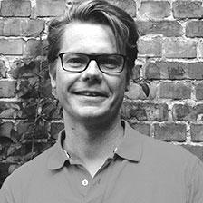
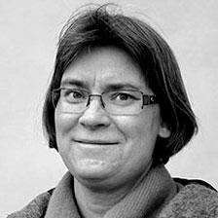
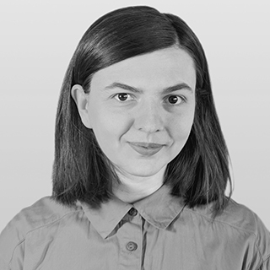
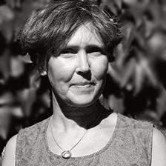
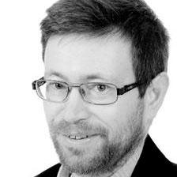
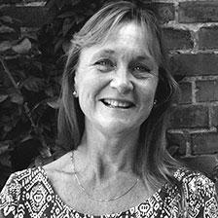
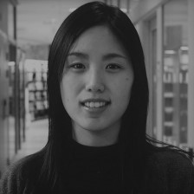
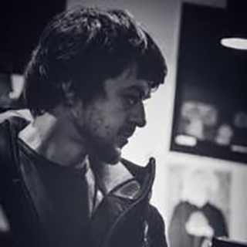
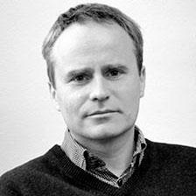
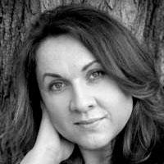
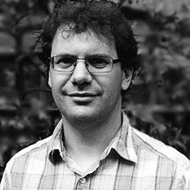
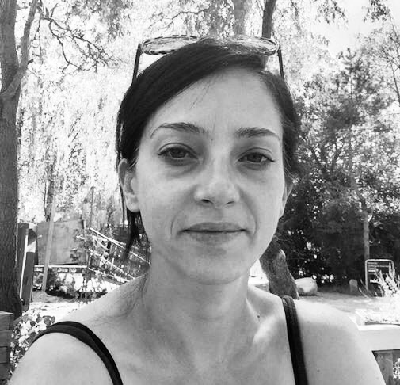
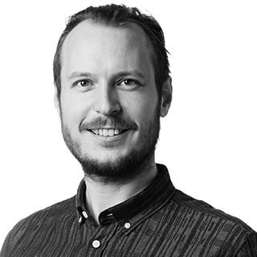
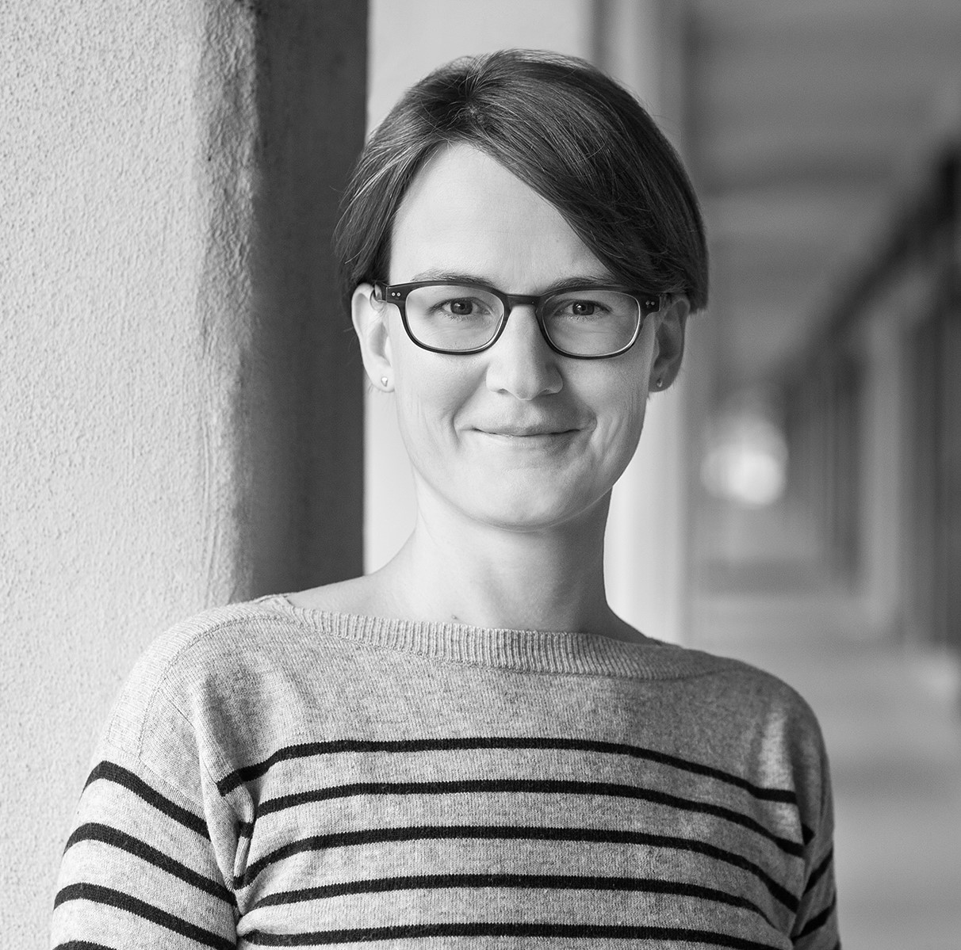
Who are we?
Håkan Johansson (PI) (prof)
Niklas Altermark (docent)
Malin Arvidson (docent)
Christofer Edling (prof)
Kerstin Jacobsson (prof)
Sara Kalm (docent)
Elzbieta Korolczuk (researcher)
Anna Meeuwisse (prof)
Roberto Scaramuzzino (docent)
Anders Uhlin (prof)
Cecilia Santilli (post doc)
Milka Ivanovska Hadjievska (post doc)
Daniel Platek (post doc)
Anders Sevelsted (post doc)
Laura Landorff (researcher)

Slide 11
www.civilsocietyelites.lu.se

Slide 12
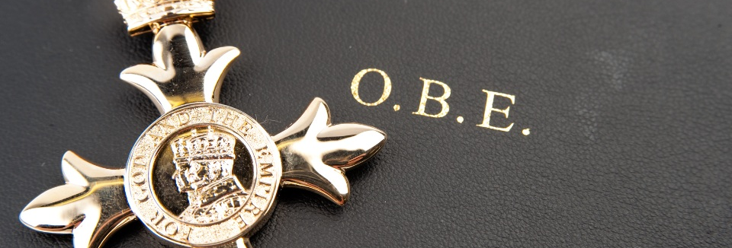
Focus for workshop

