Slide 1

FUNDING:
Finding Partners for your Nonprofit
Jeffers Miruka
President: African Society of Association Executives
@jeffersmiruka
UIA Associations Round Table Asia-Pacific: 26-27 Sept 2018 – Kuala Lumpur

Slide 2
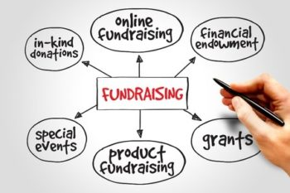
The art of Fundraising
Fundraising is... A PROCESS. Plenty of activities for Board Members and senior staff.
The elements of research, marketing, budgeting, and assessment are all fully present.
Notes:
> Fundraising is a topic and function that strikes fear into the hearts of even the most seasoned association professionals and the Boards
> Fundraising is largely viewed as asking people for money… and this often make many of us feel uncomfortable, since many of us are largely untrained in this strategic area.
> Since nonprofits and foundations exist in order to benefit the public, there must be a need for your organization to source for funds for your work in the community.
> Once you establish the need for your project, you must device a way to approach and convince donors and funders that your organization has the ability to carry out the said projects.

Slide 3

Key Considerations in Preparations
Clear mission, vision, and goals
Committed board members
Capable management, staff, and volunteers
Appropriate legal standing
Appropriate tax status
Accounting systems
Programs that are vital to the well-being of the community
Fundraising plan, which seeks support from many different sources
Facilities, equipment, and maintenance.

Slide 4
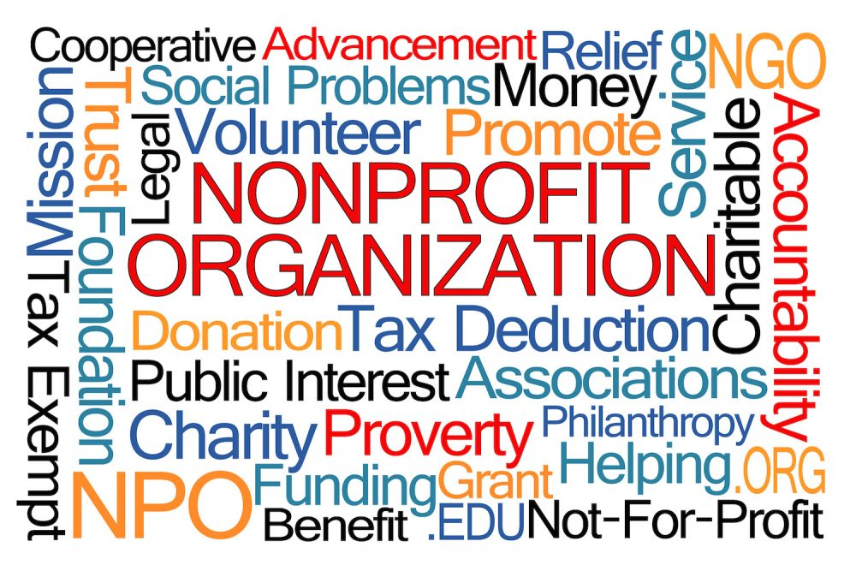
Why Donors Invest in your Nonprofit
According to the Association of Fundraising Professionals, a grant is a financial donation given to support a person, organization, project, or program.
It is typically awarded to an nonprofit from a foundation, corporation, or governmental agency.
There is an alignment between your values, ideals, and goals.
There is a deep feeling of connection and gratitude toward benefits and services (to be) received from your association.

Slide 5
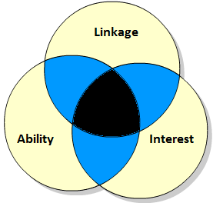
How Can we Evaluate Funding Sources?
The principle of LAI (linkage, ability, interest) is helpful when evaluating a funding source.
Linkage is any contact or access through a peer to a potential donor. (For instance, who do your board members know?)
Ability is an assessment of whether the donor is able to make a contribution.
Interest assesses the connection between your association's cause, programs, services, and market with the donor's areas of interest and support.

Slide 6
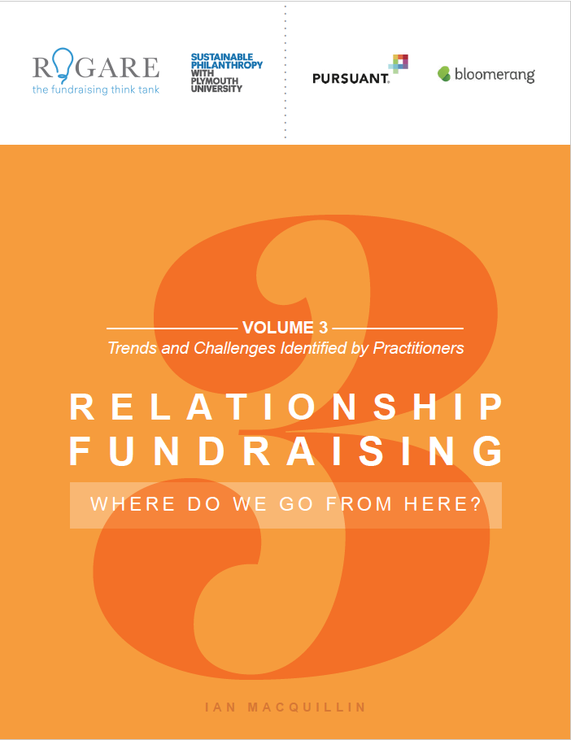
Three Tenets to Fundraising
Matching the needs of a donor with the needs of the institution – asking on behalf of an organisation, you’re part of a team. Its’ not you
Philanthropy is not logical, it is emotional – is not a logical thing. in a scale of 10 things why people give, tax deduction is no.7
Defined set of things, in a defined time period – point A to B in a series of meetings

Slide 7
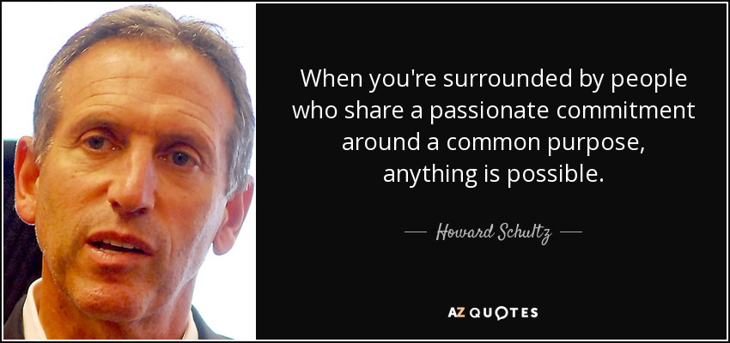
Key to Successful Fundraising
1. Commitment. Effort toward a purpose, where energy, time, and money is expended, aimed at setting goals aligned with a purpose and work toward them.
Howard Schultz, Dori Jones Yang (1997). “Pour your heart into it: how Starbucks built a company one cup at a time”

Slide 8
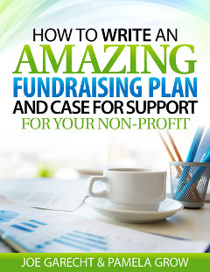
Key to Successful Fundraising
2. Case for support / case statement
Paints an emotionally compelling picture for your donors. Your non-profit should rely on your case statement as the basis for all of your fundraising communications, using language and messaging drawn straight from the case to convince your donors to give more money, more often, to support your mission.
Your fundraising plan maps out your development strategy for the next 1,2,3 or more years… and sets the direction your development program will take as you raise the money you need to thrive

Slide 9
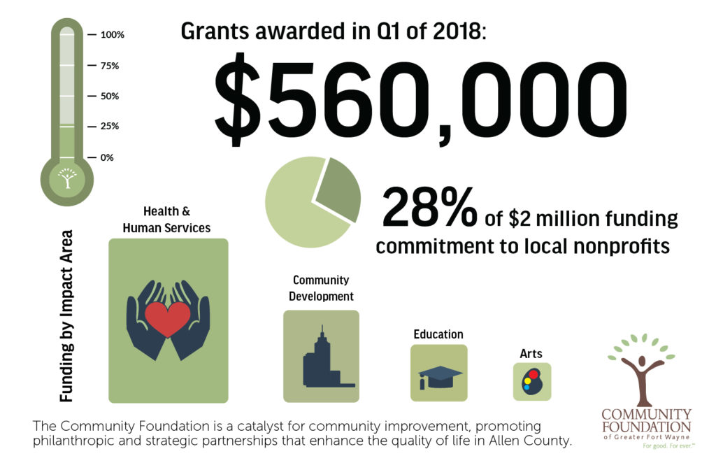
Key to Successful Fundraising
3. Local impact
How will this impact your community
Sharing your impact through stories of those you’ve helped gives a more personal and much stronger message to potential supporters as well as those in need of your help.

Slide 10

Key to Successful Fundraising
4. Storytelling for nonprofits
When we talk about nonprofit storytelling in your marketing, we’re talking about using real stories about real people who were or are in need of something that your nonprofit can provide them.
Stories pack emotion, and people act on causes that make them feel something.
Using more stories in your nonprofit marketing will engage your audience and inspire new supporters to get involved.

Slide 11
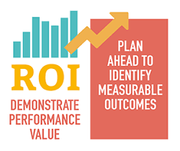
Key to Successful Fundraising
5. Measurable Outcomes
Performance improvement
Accountability
Understand how to identify measurable outcomes and outcome chains
Develop a logic model demonstrating added value
Identify performance indicators and performance targets to support the outcome measurement process

Slide 12
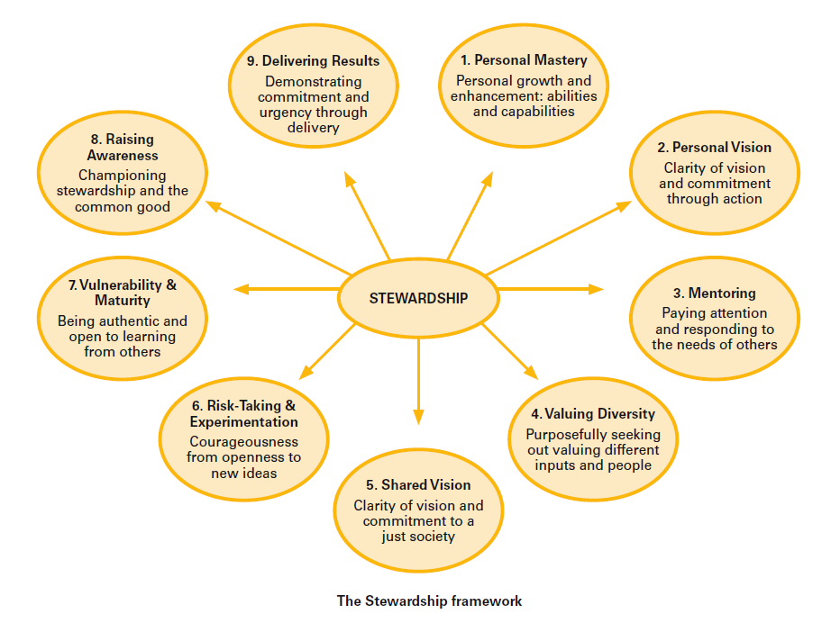
Key to Successful Fundraising
6. Stewardship is an ethic that embodies the responsible planning and management of resources.
The concepts of stewardship can be applied to nonprofit management, environment and nature, economics, health, property, information, theology, etc.

Slide 13
Fundraising Tips
Stage a thank-a-thon. Call donors and say “thank you” and this is key – with no other ask. It’s that simple. It will help your board recognize fundraising is more than an ask, it’s also about nurturing relationships and stewardship.
Never submit a cold grant - did you know foundation giving is about 7-8% of the overall fundraising pie? To get a piece of that pie build relationships. Get out and network. Research first, do your homework and be able to answer whether or not the foundation a fit with your organization. Begin with calls and/or emails.
Make Direct & Specific Asks once you understand why someone would give to your organization or program, make the ask. If you don’t ask the answer is always “no”. Be sure to position your program in the context of what the donor cares about and give a specific number (Certified Fund Raising Executive – CFRE)

Slide 14
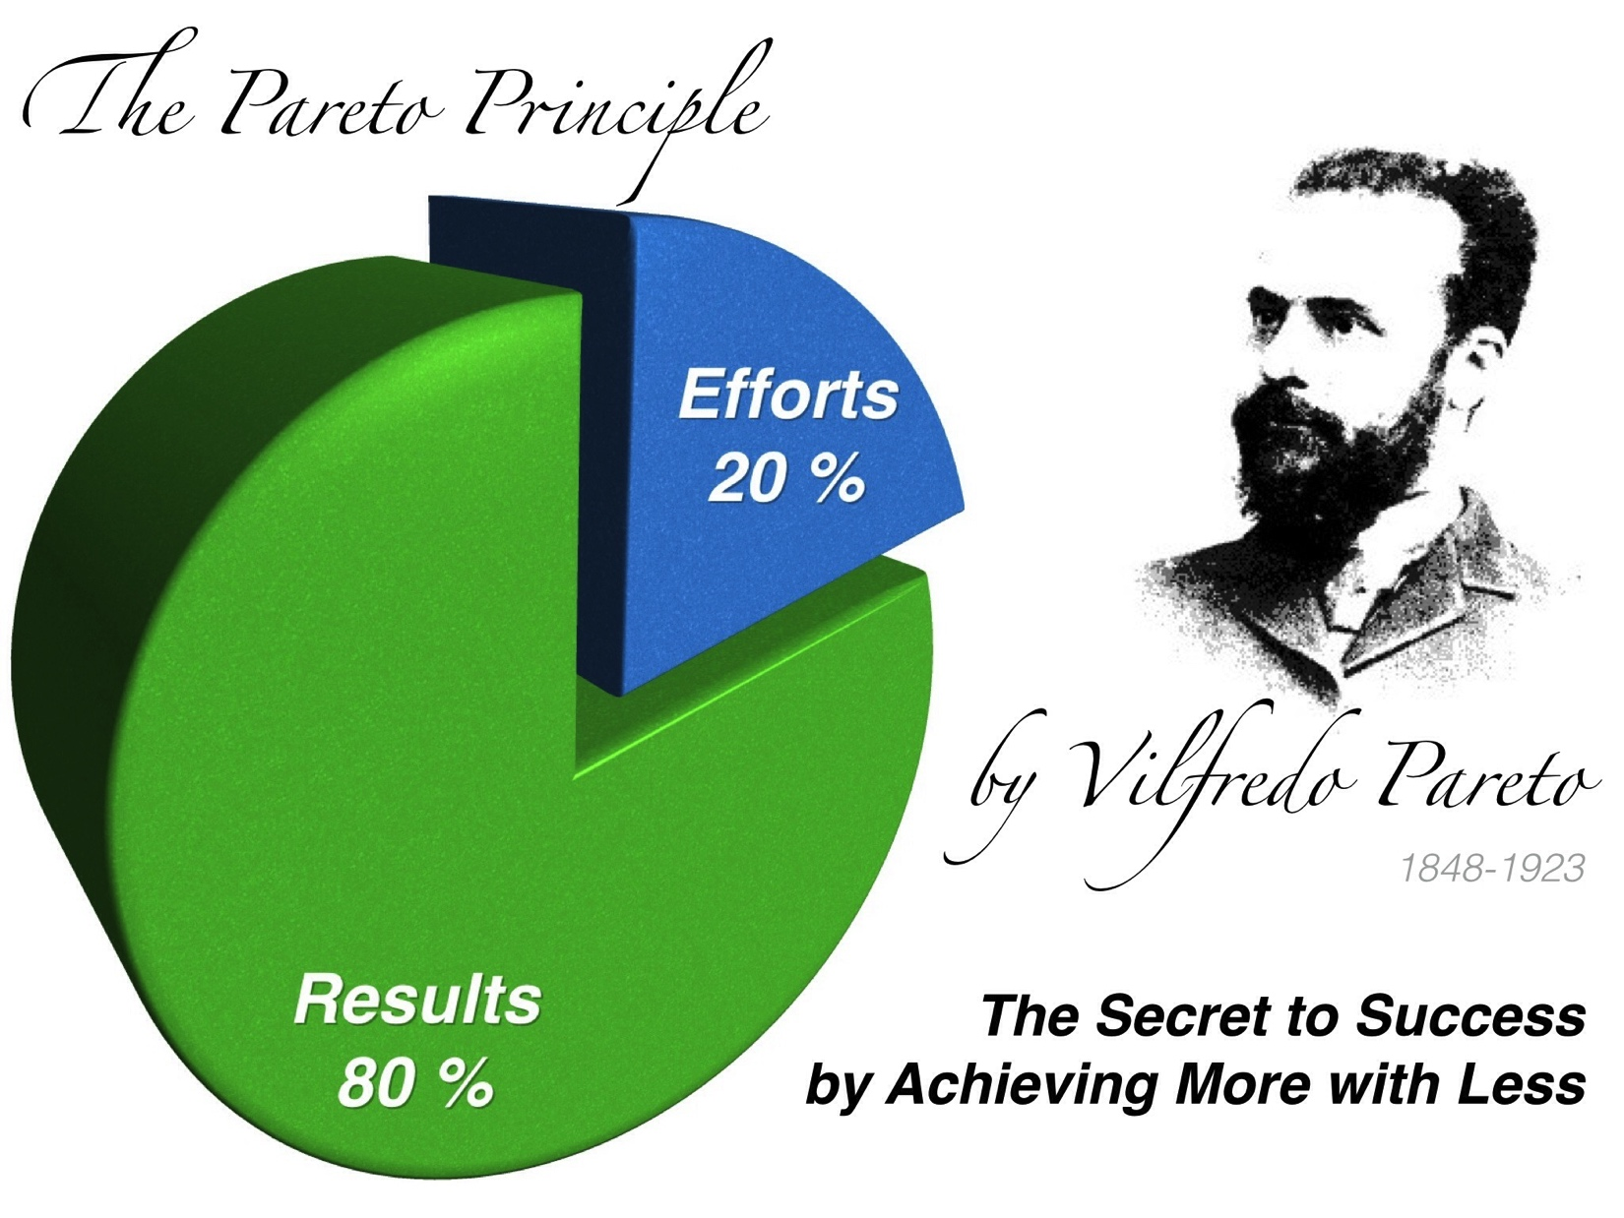
Fundraising Tips
Create and tap your social networks - meet your donors where they are – in the social networks where they spend their time. With an audience of 1.5billion users and growing, Facebook is a good place to get started. Pose questions, they engage the community more. Post at times of day when your audience is active. Also use Tinyurl, bitly, flowtown, twitterizer, google for nonprofits, and make them your social media evangelists
Map donations to impact - people don’t give to you because you have needs; they give to you because you meet needs. Donors don’t want to hear how about the “bad” economy…. They want to know where their donation went the last time and if they give to you today, how their money will be spent. Make sure to tell stories that show the impact of donor dollars

Slide 15
Fundraising Tips
Make your donation button shine - be online. Google analytics is free and a helpful way to see how people come to your organization’s website, how long they stay and when they leave. Be sure your donation button is visible on every page. And, don’t be afraid to experiment! Try different colors of your donate button. Again, Tell the story of how the money will be used, map the impact any contribution will have.
Corporate partnerships. seek corporate and media sponsorship when you plan events with lots of participants such as a gala dinner, charity walk etc. Always be sure to show the business the value of their sponsorship. Another way to develop and nurture businesses relationships is to seek in kind donations like a local bottler that can always provide water & other refreshments for your events.

Slide 16
Fundraising Tips
Apply for a Google Grant – They don’t give cash, it’s $10,000/month of free advertising on Google (Adwords). This is huge! Nonprofits take advantage of this today. It does take about 6 months to get it started.
Use the 2:1 ratio for fundraising events. to avoid the likelihood of an event losing money, create a budget of expected expenses and be conservative in the amount you estimate you will raise. If the amount you expect to raise is $2 for every $1 you spend, that’s a fundraiser.
Understand the social capital market. Earned income streams are attractive. To get started, ask yourself, how will it advance your mission?

Slide 17
Stages of A Fundraising Cycle
Your relationship with a donor usually follows a time sequence through five stages:
Identification: You identify possible donors either through prospect research or as a result of someone recommending a possible funding source.
Qualification: Before approaching a possible donor for money, your fundraising staff will need to conduct background research in order to ensure the prospect has ability to give at any level, and then to drill down further in order to see what is the best category of giving amount the prospective donor might consider.

Slide 18
Stages of A Fundraising Cycle
Cultivation: Part of tactical planning is to determine the best approach to nurture a two-way relationship with prospective donors.
Solicitation: This is the part of the cycle where and when the “ask” is made. Careful planning will pay dividends in creating relationships and in securing needed funds.
Stewardship: Part of stewardship is ensuring your association consistently expends the donors' donations according to agreed-upon terms. Consistent communication with your donors on the results being achieved as a result of their charitable gestures will likely bring ongoing and future support and appreciation from your donors.

Slide 19
Technology for nonprofits
1. Google For Nonprofits
Google for Nonprofits Program offers eligible NPOs access to free versions of paid Google products.
These tools can help nonprofits find new donors and volunteers, work more efficiently, and get supporters to take action.
They include:
  YouTube for Nonprofits Program
  Google Ad Grants
  G-Suite for Nonprofits
  Google Earth Outreach
  One Today

Slide 20
Salesforce.org
Accelerate your impact - get everything you need to grow your Nonprofit through the Power of Us product discount and donation program,
More than 32,000 nonprofit organizations and higher education institutions are using Salesforce.org
These products are:
    Nonprofit Success Pack (NPSP)
    Program Management
    Community Communications
    Marketing Communications
    Fundraising

Slide 21


