Slide 1
PARIMA is the Pan-Asia Risk and Insurance Management Association.
It is a non-profit professional association aims to strengthen the profession and culture of risk management across Asia Pacific. It is open to all who manages Risks, Security and Insurance for their organisation.
PARIMA is supported by the leading players from the insurance and risk management industry.

Slide 2
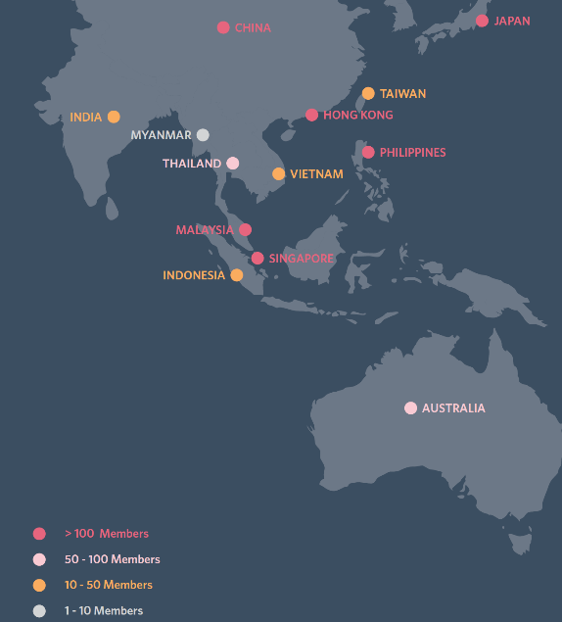
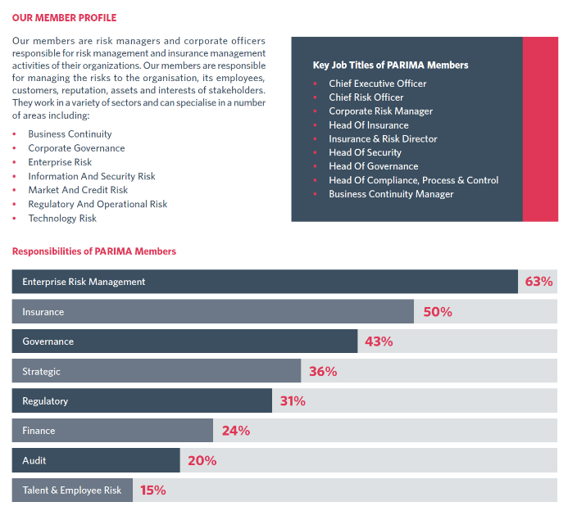
PROFILE OF OUR MEMBERS
OUR REGIONAL PRESENCE

Slide 3
1682
MEMBERS
7TH REGIONAL CONFERENCE
REPRESENTING
1002
2ND REGIONAL
CONFERENCE
6TH REGIONAL CONFERENCE
5TH REGIONAL CONFERENCE
1ST REGIONAL
CONFERENCE
4TH REGIONAL CONFERENCE
3RD REGIONAL CONFERENCE
COMPANIES

Slide 4




























Partners who support our cause

Slide 5








What do Risk Managers in Asia Pacific want?
Educational Events at Grassroots Level
“Regular activities to build a community”
“More events, workshops, seminars”
“More local workshops”
Structured & Professional Training Courses
“Risk courses. Professional Development Programmes”
“Certification and accreditation”
Networking & sharing sessions with experts
“Sharing from global and seasoned risk managers”
“Share case studies”
Resources to equip themselves with
“Build
competencies”
“Access to talent bank”
“whitepapers, tools and databases”

Slide 6


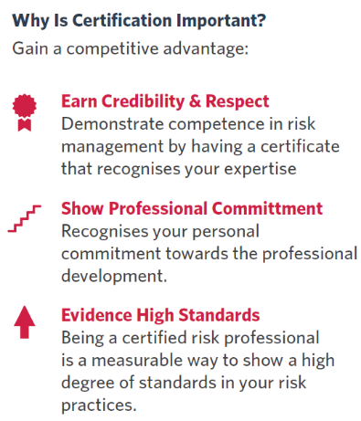
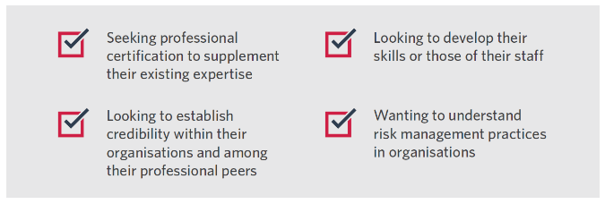


The PA-CRP Programme is designed for those who are:
See our Certification page at: www.parima.org/certification

Slide 7

30 OCTOBER 2018 - Akasaka Intercity Convention Centre
Centred on ‘Building Resilience’, this one-day event will feature topics such as Business Interruption, ART & Captives, CEOs’ Perspectives on Risk Management, Crisis Management, Cyber, Claims, D&O, Digitalisation, Risk Management, Sustainability, and many more.
http://parima.org/tokyo-2018/

