Slide 1


Finding and Keeping the right staff
Michel Ballieu

Slide 2
1 - Finding:
  The recruitment process

Slide 3
Which difficulties have you met?
Increased time & cost
Increased number of applications
Too few applications
Higher professionalism requirements
Finding the right profile
Financial expectations & fringe benefits
More competition, thus need to sell your organisation
…
Decision to hire

Slide 4
The 5 steps process
The administrative phase
The active phase
Establish a proper job description
Advertise the job
Applications management
Interviews
On boarding

Slide 5
1. Job description
Clear position title
Clarify role and responsibilities
Elements needed for evaluation
Avoid the Swiss knife

Slide 7
1. Job description
Clarify role and responsibilities
Elements needed for evaluation
Avoid the Swiss knife
One who does not have objectives, will never reach them
    Specific
    Measurable
    Achievable
    Realistic
    Time-bound
    Ethical
    Reasonnable

Slide 8
1. Job description
Clarify role and responsibilities
Elements needed for evaluation
Avoid the Swiss knife
One who does not have objectives, you will never reach them
What has to be done
What has to be achieved
What skills and experience are needed to reach the objectives
Define the relationship

Slide 9
The 5 steps process
The administrative phase
The active phase
Establish a proper job description
Advertise the job
Applications management
Interviews
On boarding

Slide 10
The 5 steps process
The administrative phase
The active phase
Establish a proper job description
Advertise the job
Applications management
Interviews
On boarding

Slide 11
3. Applications management
Collecting & sorting - 2 categories:
  Rejected
  Non-rejected
Defining a “long list” to be interviewed
Everyone deserves a reply

Slide 12
The 5 steps process
The administrative phase
The active phase
Establish a proper job description
Advertise the job
Applications management
Interviews
On boarding

Slide 13
4. Interviews
By phone
Face to-face #1
Tests
Face-to-face #2
Face-to-face #3
Negotiation
long list
short list
(?)
super short list
if needed

Slide 14
The 5 steps process
The administrative phase
The active phase
Establish a proper job description
Advertise the job
Applications management
Interviews
On boarding

Slide 15
2 - Keeping:
  “keeping my customers satisfied”
staff

Slide 16
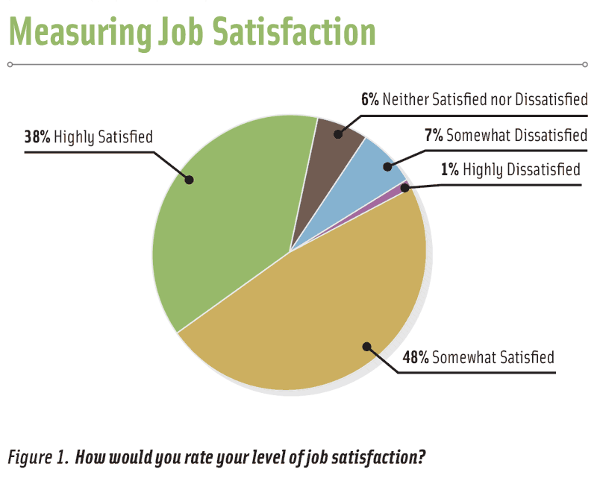

Slide 17
Job Satisfaction Evolution

Slide 18
Satisfied about what?
Intrinsic (work itself)
Content of the work
Responsibilities
Sense of identity/self-worth/contribution
Extrinsic (work conditions)

Slide 20
Satisfied about what?
Intrinsic (work itself)
Content of the work
Responsibilities
Sense of identity/self-worth/contribution
Extrinsic (work conditions)
Work environment
Salary
Job security
Relationship

Slide 21
6 key factors to job satisfaction
FACTORS
Respect, praise, appreciation
Trust
Individual growth/education
A good boss
Compatible co-workers
Life balance
RESULTS
Engagement, sense of contribution
Able to use own skills & talents
Impact on colleagues
Active contribution to a bigger purpose

Slide 22




Education

Slide 23
Take home message
To keep our staff:
let’s keep the human sense in our leadership behaviour
The Values we like – the values we live

Slide 24

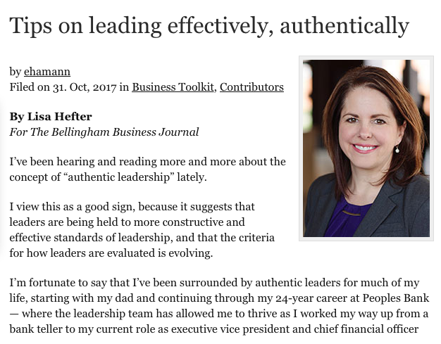
Authentic Leadership

