Slide 1
Burning legal questions for international associations
Sarah Verschaeve Sarah van den Brande
Counsel, Curia CVOA Counsel, Curia CVOA
10 November 2017
UIA Round Table
Brussels

Slide 2
Topics
Changing legislative framework for (international) associations
  Current legal framework: NPO-Law
  Future legislation: Unified Code on Companies and Associations?
  New insolvency legislation also applicable to non-profit entities
Brexit and how to continue benefiting from EU funding?
GDPR

Slide 3
1. a) Current legal framework: NPO-Law
INPA’s: governed by Title III of the Law of 27 June 1921 (NPO-Law)
  Art. 46-58
Belgium: only country providing a specific legal status for INPA’s
Non-profit purpose serving an international interest (art. 46 NPO-Law)
Created to promote international collaboration in a not-for-profit context
Recognized by Royal Decree
Membership organization
Only limited imperative legal provisions

Slide 4
1. a) Current legal framework: careful with commercial activities
Text of the NPO-Law (art. 46 juncto art. 1 NPO-Law):
  Prohibition on commercial activities
  Interpretation of the NPO-Law:
  Tolerance for secondary commercial activities
  Stretch on commercial activities
  Different criteria to determine secondary character
  Potential risks
  How to reduce the risks?

Slide 5
1. a) Current legal framework: directors’ liability
No specific rules in NPO-Law
Civil law:
  Internal liability: agency theory
  External liability in tort (art. 1382-1383 Civil Code)
  Individual liability
  Joint liability in case of repeated non-payment of VAT (art. 93 undecies C VAT Code) and withholding tax (art. 442 quater Income Tax Code)
  Prescription periods (art. 2262 bis Civil Code):
    Contractual liability: 10 years
    Non-contractual liability: 5 years / 20 years

Slide 6
1. a) Current legal framework: directors’ liability
Mechanisms to limit or cover the risk of personal liability
  Paper trail
  Execution of mandate as a legal entity?
  Hold harmless clause
  Insurance
  Etc.

Slide 7
1. a) Current legal framework: directors’ liability
Mechanisms to limit or cover the risk of personal liability
  Paper trail
  Execution of mandate as a legal entity?
  Hold harmless clause
  Insurance
  Etc.

Slide 8
1. b) Future legislation: Unified Code on Companies and Associations (?)
Current status
Underlying principles
  Simplification
  More flexibility
  Adapting to European evolutions
  Code contains books with common provisions for companies and associations (incorporation, publication, administration, nullity, liability, dissolution, …)
  Specific book applicable to NPA’s, INPA’s and foundations
  Publication expected in first half 2018
  Important disclaimer: in theory everything can still change!

Slide 9
1. b) Future legislation: Unified Code on Companies and Associations (?)
Entry info force - transitional provisions (based on draft bill)
  1st day of 1st financial year that commences after the expiry of a period of 1 year after the publication of the Code: entry into force
  At the occasion of the 1st change of the AoA and ultimately 10 years after the entry into force: alignment of AoA with Code
  As of entry into force: imperative provisions (e.g. transformation of capital into unavailable reserves) become applicable
  As of 10th day after publication: certain legal forms (abolished by the new Code) can no longer be incorporated (e.g. trade association, company with a social purpose* (in current form))
  At the 10th anniversary of publication of the Code: automatic transformation of certain (abolished) legal forms into preserved legal forms (e.g. trade association transforms into NPA)
  *“Company with social purpose” becomes a “social enterprise”

Slide 10
1. b) Unified Code on Companies and Associations: Impact on (international) associations
Most important change:
  Liberalizing of commercial activities for NPA’s and INPA’s
    Non-profit purpose (of international interest) is maintained
    Strict prohibition to distribute direct or indirect patrimonial benefits to founders/members/directors/other persons (except, in the latter case, if this serves the non-profit purpose of the NPA/INPA)
  But no (immediate) modification of other legislation?
    Impact on taxation
    Impact on legislation applicable to volunteers
    Impact on subsidies
    …

Slide 11
1. b) Unified Code on Companies and Associations: Impact on (international) associations
Other important change:
  Directors’ liability
    Joint and several liability of directors for violations of the Code and AoA
      Release from liability if director notifies other directors of mistake
    Limitation of liability: maximum caps based on turnover and balance sheet total (not in case of fraud, etc.)

Slide 12
1. b) Unified Code on Companies and Associations: Impact on (international) associations
Maximum cap | Turnover and balance total
€ 125,000 | turnover less than € 350,000 (VAT excl.) balance total of maximum € 175,000
€ 250,000 | turnover less than € 700,000 (VAT excl.) balance total of maximum € 350,000
€ 1,000,000 | turnover of maximum € 9,000,000 (VAT excl.) balance total of maximum € 4,500,000
€ 3,000,000 | Turnover more than € 9,000,000 and less than € 50,000,000 Balance total more than € 4,500,000 and less than € 43,000,000
€ 12,000,000 | turnover greater than or equal to € 50,000,000 (VAT excl.) balance total greater than or equal to € 43,000,000

Slide 13
1. b) Unified Code on Companies and Associations: Impact on (international) associations
    Joint liability in case of repeated non-payment of VAT and withholding tax: status quo
    Shortening of prescription period: 5 years (same as current regime for companies)
    Exoneration and hold harmless clauses: not possible by entity in which mandate is exercised (nor in controlled entity)
    Obligation for (I)NPO-director to appoint a natural person as permanent representative (same as for companies; including liability of natural person-representative)

Slide 14
1. c) New insolvency legislation, also applicable to not-for-profit entities
New insolvency legislation (Law of 11 August 2017) enters into force on 1 May 2018 (Book XX of the Economic Law Code) and brings together:
  Continuity of Enterprises Act
  Bankruptcy Act
  Broadened scope ratione personae:
  “Enterprises”
    any individual who independently exercises a professional activity;
    any legal entity (also (I)NPA’s and foundations); and
    any organization without legal personality.
  Directors’ liability in case of bankruptcy
  Rules on directors’ liability: moved from Companies Code to Book XX Economic Law Code

Slide 15
1. c) New insolvency legislation, also applicable to not-for-profit entities
Applicable to all enterprises with the exception of individuals who exercise a professional activity independently
Who?
    Current or former directors, managers, managing directors, members of the board of directors or supervisory board, and all other persons who had real managing authority in respect of the business of the enterprise
Directors’ liability in case of:
  A manifestly gross error that has contributed to bankruptcy
    Not applicable to ‘small enterprises’ (= enterprises who have, over the last 3 financial years before the bankruptcy, or, if the enterprise was established less than 3 years before the bankruptcy, over the financial years before the bankruptcy, accomplished an average turnover of € 620,000 (VAT excluded), and a balance sheet total of maximum € 370,000)
    (Joint) liability for all or part of the debts (not exceeding the deficit)

Slide 16
1. c) New insolvency legislation, also applicable to not-for-profit entities
  Unpaid social security contributions/VAT/withholding tax
    (Joint) liability for all or part of the unpaid contributions/taxes if involved in at least 2 bankruptcies or liquidations with unpaid debts vis-à-vis social security/tax authorities during 5 years prior to the declaration of bankruptcy
  Manifestly no reasonable prospect of avoiding bankruptcy + directors did not act as a normally prudent and careful director would have acted in the same circumstances;
    (Joint) liability for all or part of the debts (not exceeding the deficit)

Slide 17
2. Brexit and how to continue benefiting from
EU funding
Concern for INPA’s established in the UK
Based on past year experience:
  Significant number of UK international associations are contemplating to move their activities to the continent / establish a subsidiary in countries such as Belgium or Ireland
  “Presence” in Belgium can take different forms
  Representation office
  Center of activities
  Non-profit legal entity (NPA, INPA, foundation)
  But: type of “presence” may have impact on eligibility for (EU) funding

Slide 18
2. Brexit and how to continue benefiting from
EU funding
  Under many EU financing instruments, the beneficiary needs to be “effectively established” in a EU member state in order to be eligible for funding
  If contracting authority suspects non-compliance with nationality rules: demonstrate that “real seat” is within eligible State
    Real seat = place where the managing board and central administration are located or its principal place of business
    Avoid “letter box” entities
  Minimum duration of existence?

Slide 19
2. Brexit and how to continue benefiting from
EU funding
  How to establish control of the Belgian subsidiary?
  Direct control
  Indirect control
  Can the Belgian entity rely on the financial/technical capacity of the UK entity to demonstrate that it meets the selection criteria?
  Important to pre-screen the EU financing instruments under which the INPA may qualify and determine the applicable eligibility and selection criteria (these may, however, still vary depending on the individual financing decision / tender concerned!)

Slide 20

GDPR
Part of data protection legislation

Slide 21
3. GDPR – part of data protection legislation
  Data Protection Legislation
  General: Privacy Act of 1992; outdated (internet) and national
  Specific: CLA 81 on the protection of the privacy of workers with regard to the control of electronic online communication data…
New! General Data Protection Regulation (GDPR)
  Entered into force on 24 May 2016, applicable from 25 May 2018
  Europe; (partial) replacement for national legislation
  Higher sanction risk:
    Privacy commission
    Fines
    Reversal burden of proof

Slide 22
Personal data
Definition
  All information which can identify a physical person (directly or indirectly)
  This means: data of anyone of us
  Not:
    Legal entity (association, company…), as far as no personal data is contained therein
    Anonymous data

Slide 23
Processing
Definition
  Any use of personal data
    Collection, recording, organisation, structuring, storage, adaptation or alteration, retrieval, consultation, use, disclosure by transmission, dissemination or otherwise making available, alignment or combination, restriction, erasure or destruction
  Not:
    Non automated and non organised system
    Merely for personal or household activities (address file)

Slide 24
Examples
Personal data
  Name
  Telephone number and email address:
  private >< professional; direct >< indirect sarah.vandenbrande@gmail.com >< sarah.vandenbrande@curia.be >< info@curia.be
  Address, IP address
  Photo, tattoo, fingerprint
  Bank account
Processing
  Reading, saving, or filling in a form
  Making reservations, placing an order
  Subscribing for a course/seminar/sports club…

Slide 25
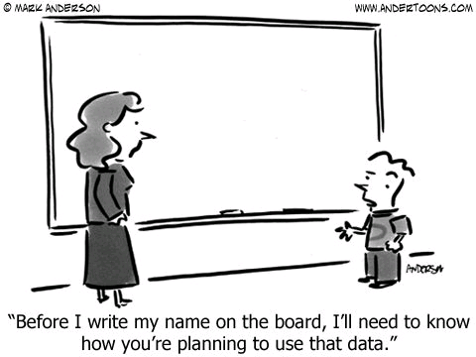
Basic principles

Slide 26
Basic principles of data protection
Lawfulness, fairness and transparency
Confidentiality and accuracy
Specified purpose, data minimization and limited storage
➔ All specific obligations follow from these basic principles

Slide 27
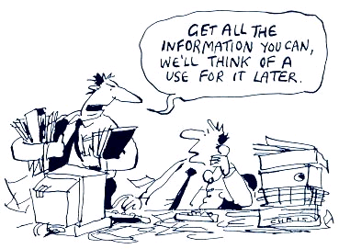
Lawful grounds for processing personal data

Slide 28
Lawful ground (1/2)
  Legal obligation (taxes, Dimona, publication bylaws)
  Interests
  Vital (medical data unconscious victim)
  Public interest or official authority (NMBS, Bpost, Police)
  Legitimate interest (concern)
Necessary for the performance of a contract
  Data for invoice, address, name...
  Substantial ground for processing in light of employment agreement
    Name, bank account, dependent children…

Slide 29
Lawful ground (2/2)
Freely given, specific, informed and unambiguous consent
  Choice; careful with balance of power
  Informed, transparent and specific (clear and understandable)
  No vague or broad descriptions (specified purpose)
Active deed (not implicit; only explicit)
  Only opt-in, no opt-out! (no pre-ticked boxes)
  Check prior consents
Burden of proof with controller
  Writing is advised
  Importance of privacy statement, (work)rules (signature)
Subject can withdraw consent

Slide 30
Elevated protection
Sensitive data:
  Race, religion, politics, genetics, health, sexual preference…
  National registry number/criminal record:
  Law/public authority/authorization
  ID card: retrieve, read in, copy, warranty
  Children: consent parents and possibly child (e.g. from age 12, 14, 16)

Slide 31
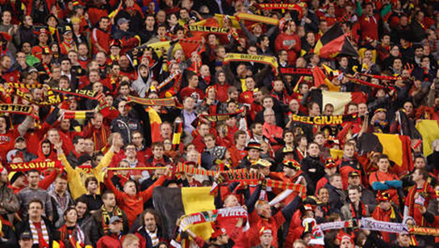
Photo
In principle consent needed when capturing and publishing, unless
  On a public place
  In a crowd
  Public figures (informative)
  Application
  Elections, football game
  Employees on company website?
  Attention: rights of photographer (copyright)

Slide 32
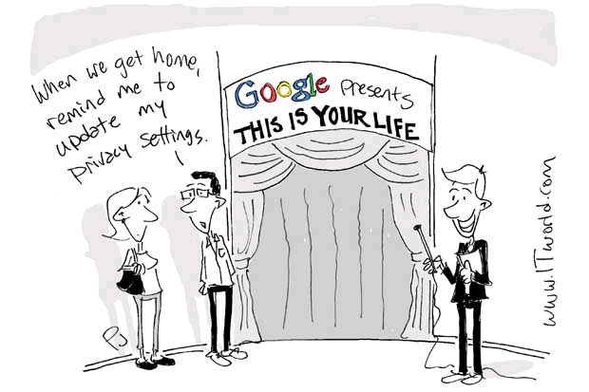
What to do by 25 May 2018

Slide 33
Overview
Awareness and audit
Data protection team and data protection officer
Data register
Privacy policy
Lawful ground, consent, children
Technical measures
Mandatory notification data breach
Pm notification of Privacy commission abolished

Slide 34
Awareness and audit
Inform key people, policy makers and employees
Audit
  ! Visual parameters and evolution, e.g. sheets, charts…
  Which personal data?
  How obtained? (data subject or third party?)
  Lawful ground? (active consent? Initial purpose contract?)
  Retention period?
  Transfer to third parties?
  Direct marketing?
  Up-to-date?
  Technical aspects

Slide 35
Data protection team and DPO
Compiling a data protection team
DPO (if necessary):
  Public authority
  Processing that requires regular and systematic monitoring on a large scale
  Mainly sensitive data / data relating to criminal convictions and offences
  Intern / extern: independent

Slide 36
Data register
Which personal data?
Where collected from?
Shared with whom?
Protected how?
Purpose?
In writing and electronic
Not mandatory for enterprises < 250 employees, unless:
  Not occasional
  Processing of sensitive data (hospitals)
  Risks to the rights and freedoms of data subjects (broad)

Slide 37
Technical security and data breach notification
New! Determining risks and security level
Tips:
  Pseudonymisation
  Anti-virus, firewall, pass word, log out
  Attention with the cloud (server location)
  Confidentiality and guarantees with ICT providers
  Physical security (closing)
New! Notification of breach within 72 h after awareness
  To Privacy commission
  To data subject in case of high risk

Slide 38


Thank you for your attention
Questions?
Sarah van den Brande
sarah.vandenbrande@curia.be
Sarah Verschaeve
sarah.verschaeve@curia.be

